Slide 1
Transcribe That!
An Expository Study in Using Machine Learning to Classify Drum Sounds
Michelle Blum, Greg Zajac
MATG 657

Slide 2
Background
Drumming, like Math, has two layers.
Theory
Hand/Foot Technique (Rudiments)
Limb Interdependence
Metric Modulation/Polyrhythms
Application
Making music
Question: How does one distinguish themselves “musically” on the drums?

Slide 3
Background
Transcription – Writing down, note for note, what a musician is playing
Purposes of Transcriptions
Examples of “Theory” successfully put into practice
Expands “musical vocabulary”
Documents the playing of great musicians
Develop your own “musical identity”

Slide 4
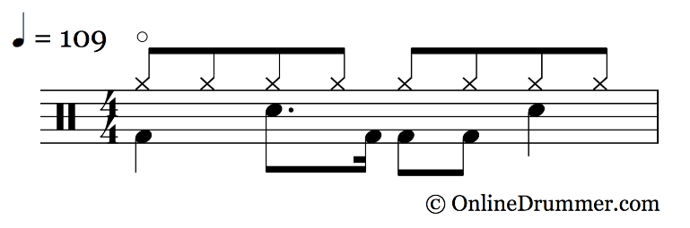

Examples of Transcriptions

Slide 5
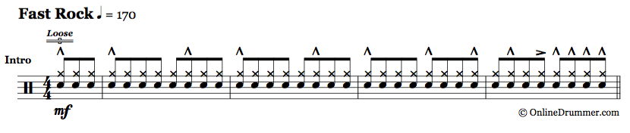
Examples of Transcriptions

Slide 6
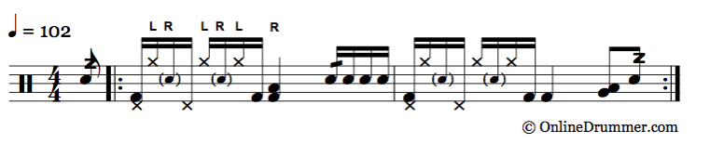
Examples of Transcriptions

Slide 7
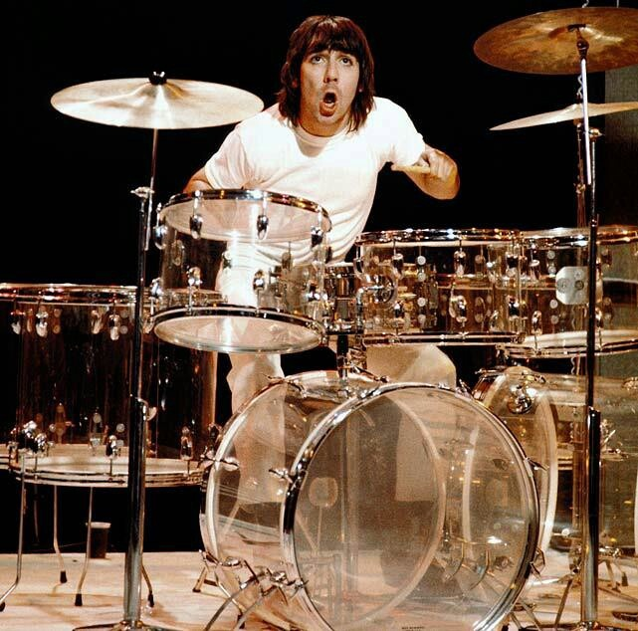

Motivation

Slide 8
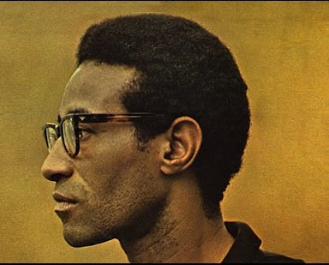
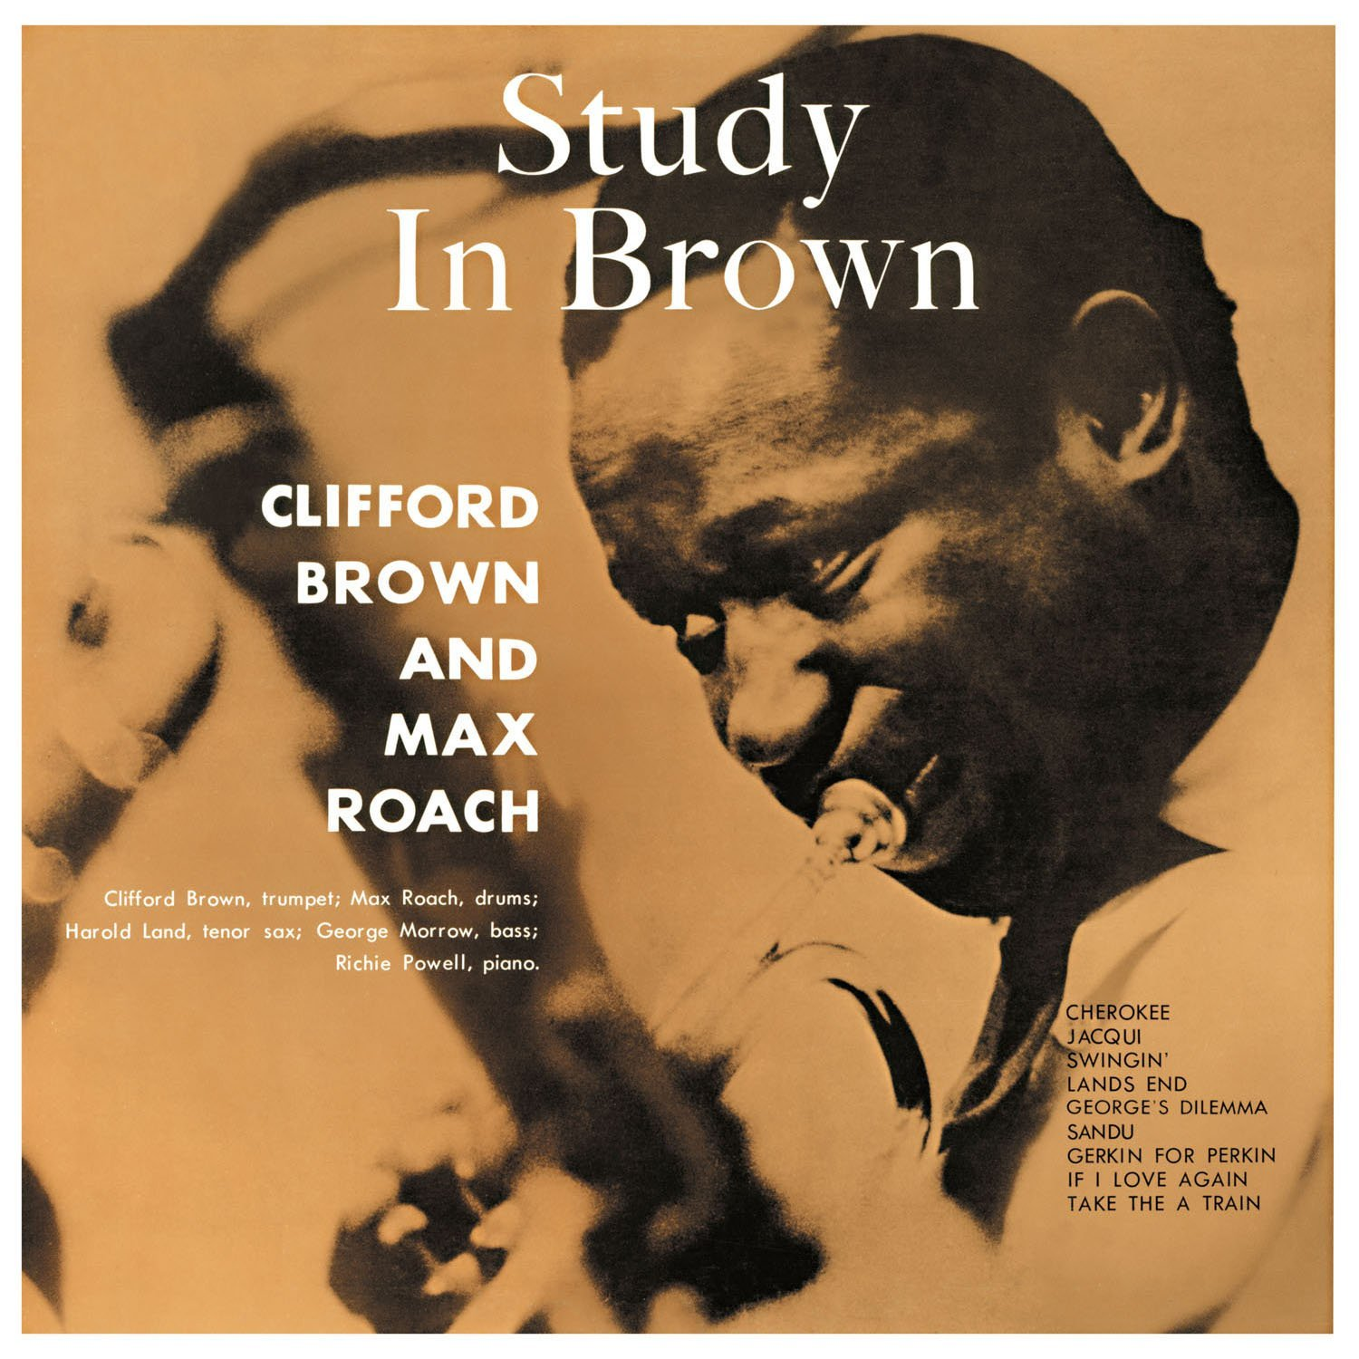
Motivation

Slide 9
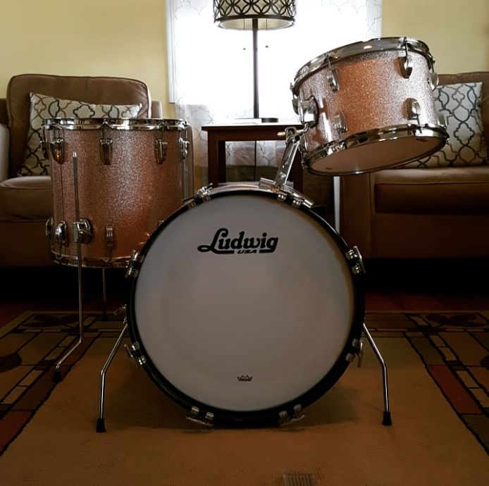
Our Project
Goal: Utilize Machine Learning to classify drums based on their sound – first step in automating Transcription Process.

Slide 10
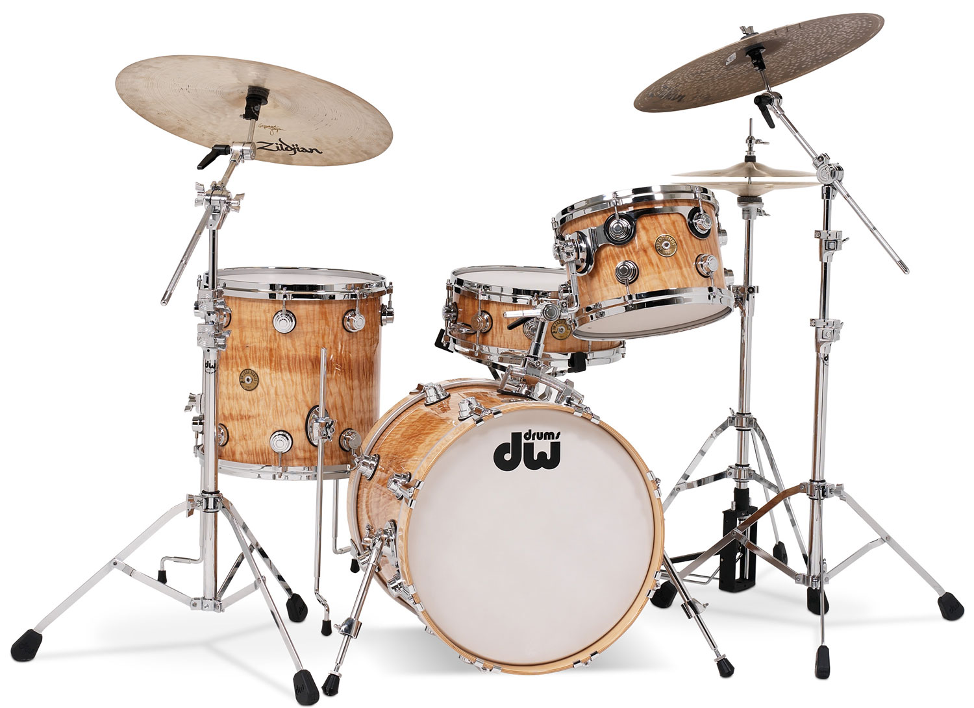
Tom Tom
Snare
Floor Tom
Bass

Slide 11
The Data
Audio recordings of a four-piece drum set
Snare, Tom-Tom, Floor Tom, Bass Drum
One master recording for each type of drum
Needed to convert each audio file to mono
Each “hit” is a data point
Manually parse each audio file in Audacity
49 Snare hits
73 Tom-Tom hits
68 Floor Tom hits
84 Bass Drum hits

Slide 12
The Data
Automatic parsing is possible, would have been next step in further developing the project
Find spikes within wave and parse data at these locations
Place resulting parsed matrices into cell array
Our issue: Choosing a threshold value of window where ratio of increase is large enough for a cut

Slide 13
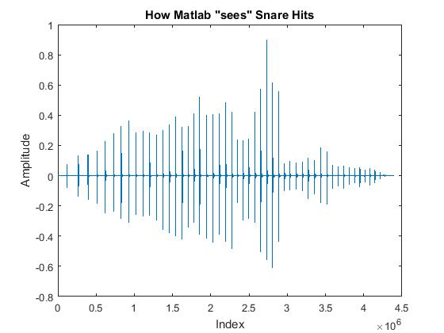

Slide 14
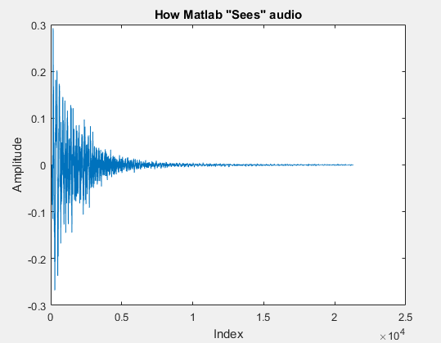
The Data
Read each mono audio file into Matlab using audioread
audioread returns a vector of amplitudes and the sampling frequency

Slide 15
Feature Extraction
The heart of the project
Follow Occam’s Razor
Keep it simple!

Slide 16
Feature Extraction
Can’t use amplitude as a feature – just measures how hard each drum was hit
Knew that each drum has distinct frequency
Used Fast Fourier Transform to move into the frequency domain
Now, with a vector of frequencies, can extract data from this
Issue: FFT Matlab function does not account for noise
Used threshold value to solve (Maximum)
“Cutoff Frequencies”
Snare: 800
Tom-tom: 460
Floor Tom: 360
Bass: 80

Slide 17
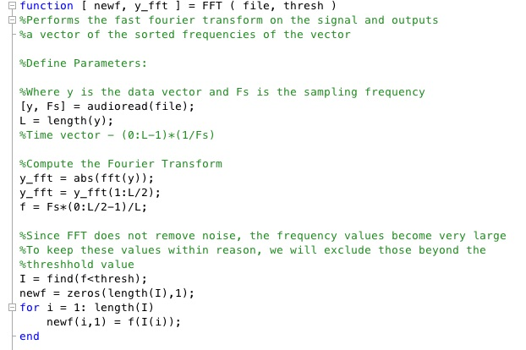

Slide 18
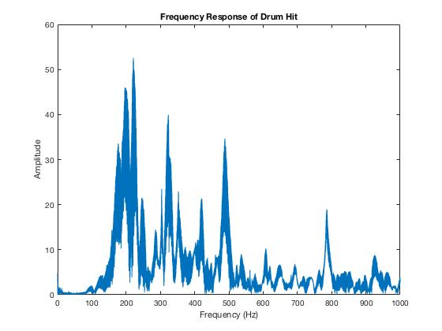

Slide 20
Feature Extraction
Compared one-dimensional separation of data for
Maximum frequency
Average frequency
Standard deviation of frequency
Median frequency
Skewness of frequency
Kurtosis of frequency

Slide 21
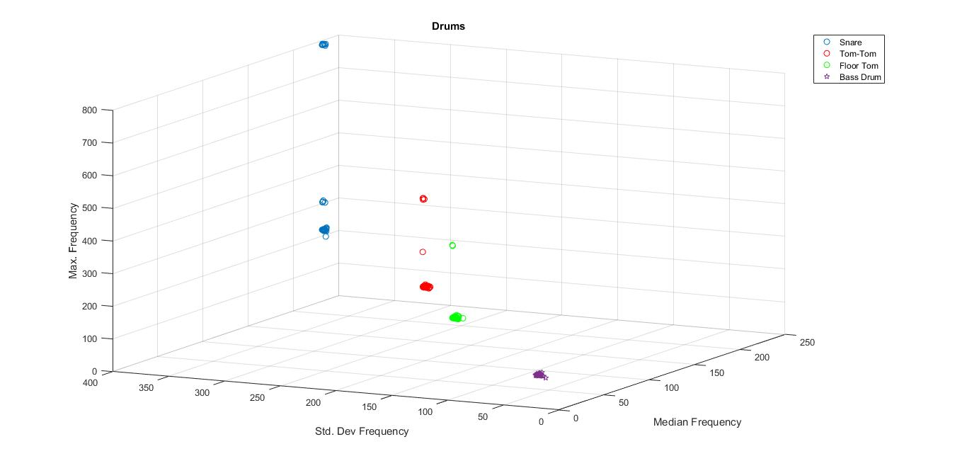
Feature Extraction

Slide 22
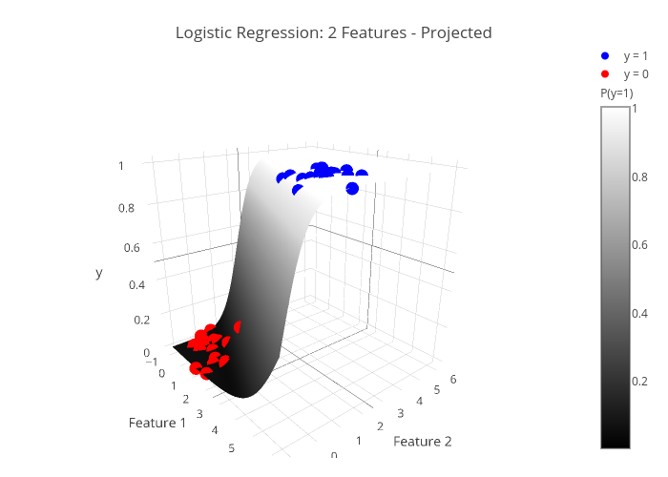
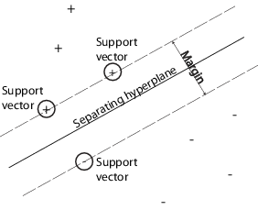
Training Classifiers
Two simple Linear Discriminant Functions (LDF)
Logistic Regression
Support Vector Machine

Slide 23
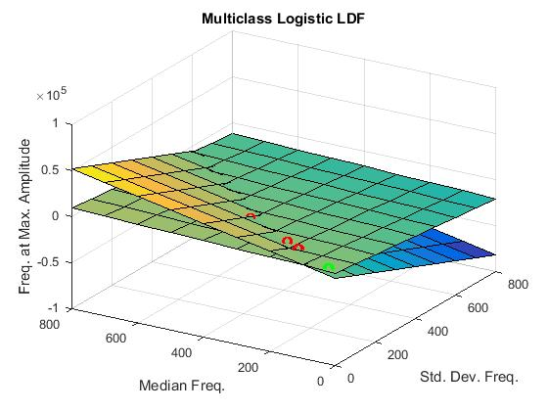
Logistic Regression

Slide 24
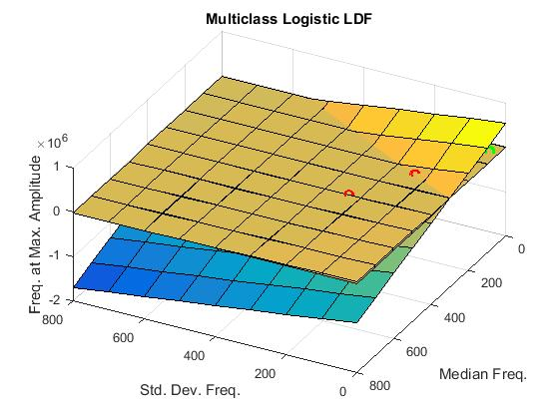
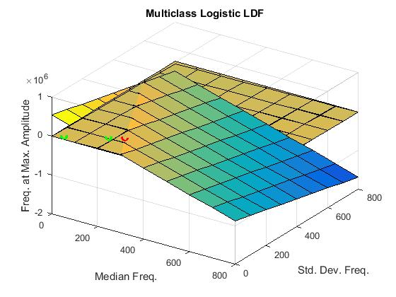
Logistic Regression

Slide 25
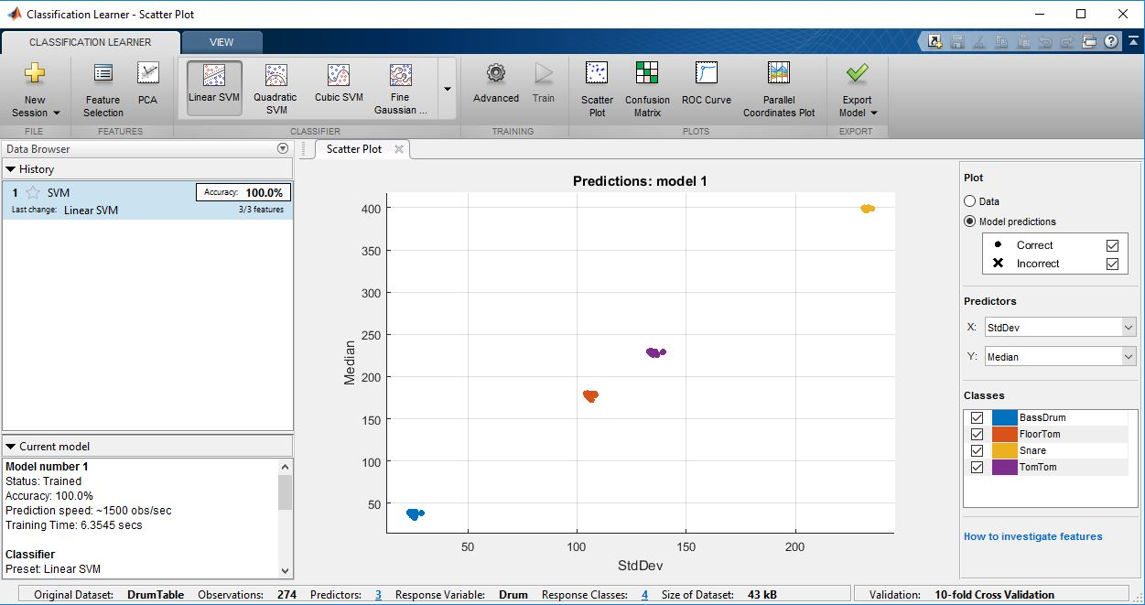
SVM

Slide 26
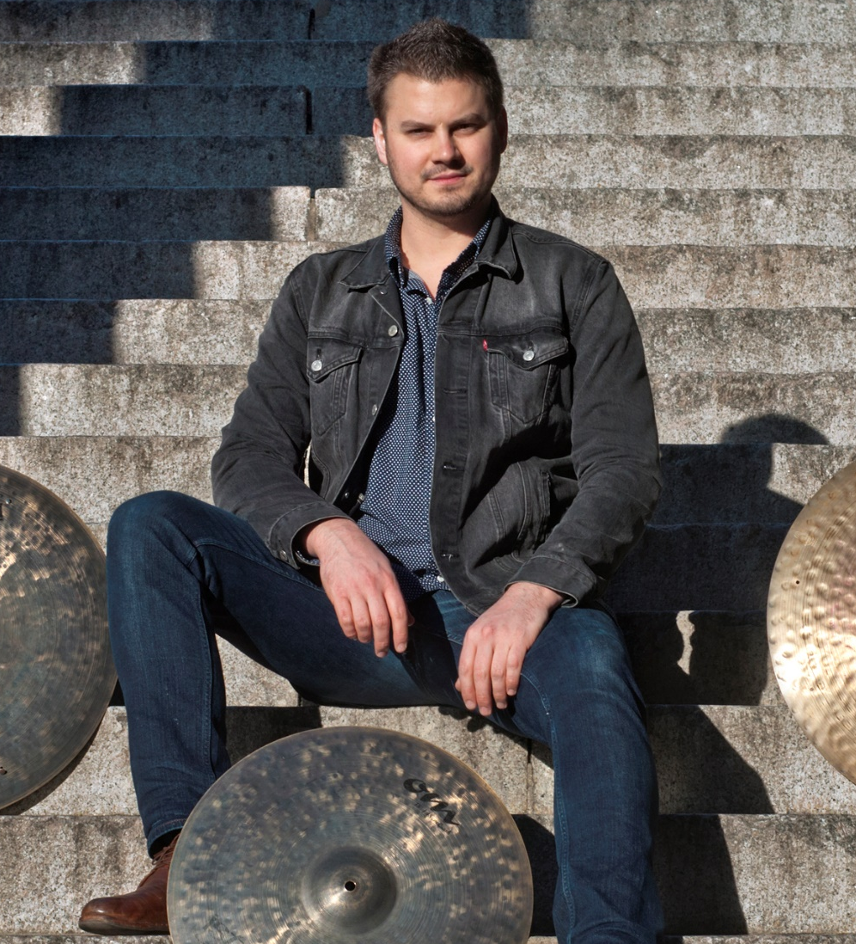

Testing the Model on New Data

Slide 27
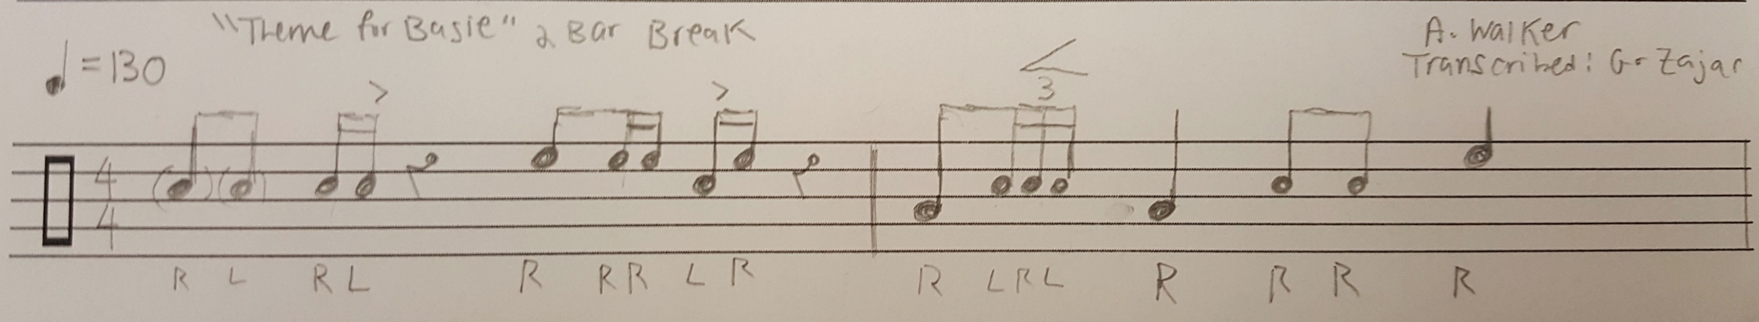
Testing the Model on New Data

Slide 28
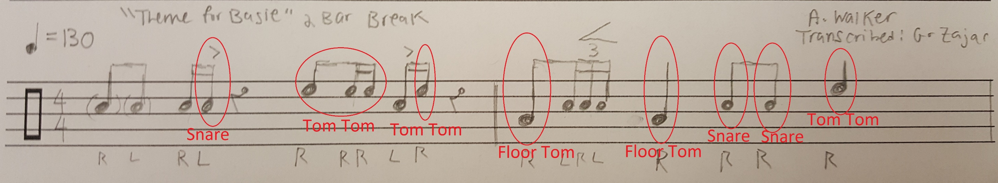
Testing the Model on New Data

Slide 29
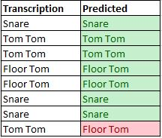
Results

Slide 30
Future Work
Classify (with) Cymbals
Classify more drums
Different Tunings, Different Genres
Classify with noise (other instruments)
Automated Audio Parsing

Slide 31
Bibliography
Excerpt from Walk this Way by Aerosmith from their album Aerosmith’s Greatest Hits, 1975. All credit goes to Aerosmith and the respective license holders.
http://www.onlinedrummer.com/drum-beats/walk-this-way-aerosmith-2/
Excerpt from Rock and Roll by Led Zeppelin from their album Led Zeppelin IV, 1971. All credit goes to Led Zeppelin and the respective license holders.
http://www.onlinedrummer.com/drum-beats/rock-and-roll-led-zeppelin-intro/
Excerpt from 50 Ways to Leave Your Lover by Paul Simon from his album The Essential Paul Simon, 1975. All credit goes to Paul Simon and the respective license holders.
http://www.onlinedrummer.com/drum-beats/50-ways-to-leave-your-lover-intro-paul-simon/

Slide 32
Bibliography
https://s-media-cache-ak0.pinimg.com/736x/12/3e/01/123e018db769d36d18ea40ba75daca56.jpg
https://upload.wikimedia.org/wikipedia/en/1/19/Tommyalbumcover.jpg
https://i.ytimg.com/vi/Fzc4P9n0014/hqdefault.jpg
https://images-na.ssl-images-amazon.com/images/I/81bAzn2BM4L._SL1500_.jpg
http://www.austinwalkermusic.com/wp/wp-content/uploads/2014/11/austin_3.jpg
https://sugarhilltrio.bandcamp.com/album/the-drive
Excerpt from Theme For Basie by the Sugar Hill Trio from their album The Drive, 2016. All credit goes to the respective songwriter and license owners.

Slide 33
Bibliography
https://florianhartl.com/logistic-regression-geometric-intuition.html
https://www.mathworks.com/help/stats/support-vector-machines-for-binary-classification.html

Slide 34
Questions?
Thanks!!!

